Slide 1
Bike Rental Shop Database
Allen Sheu and Nicholas Force

Slide 2
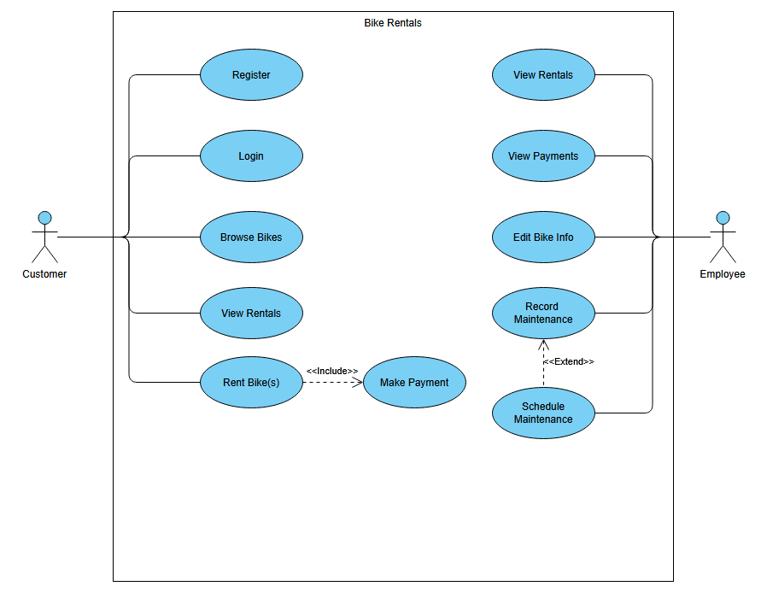
This goal of this database is to log all rental and maintenance events for the bikes in the shop. It will record all past and present customers, and the necessary data to track their rentals, including payment history and rental status. Finally, the database should keep track all our bikes, including their service history and availability for future customers.
Customers should be able to login or register to make rentals, view the status of their rentals, make payments, and browse available bikes.
Employees should be able to view all rentals, view all past and pending payments, edit bike information, and record and/or schedule maintenance.

Slide 3
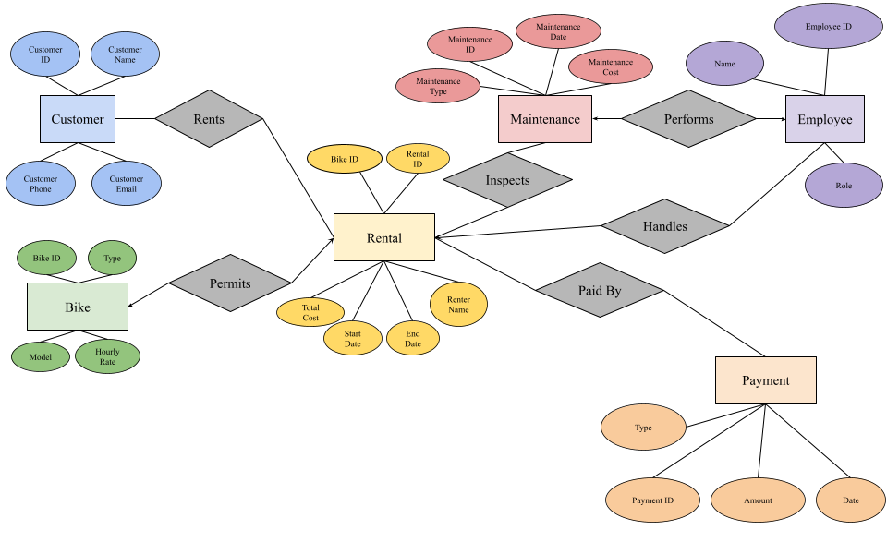
E/R Diagram of the database, showing the relations and elements of each entity, not including junction tables and foreign keys.

Slide 4
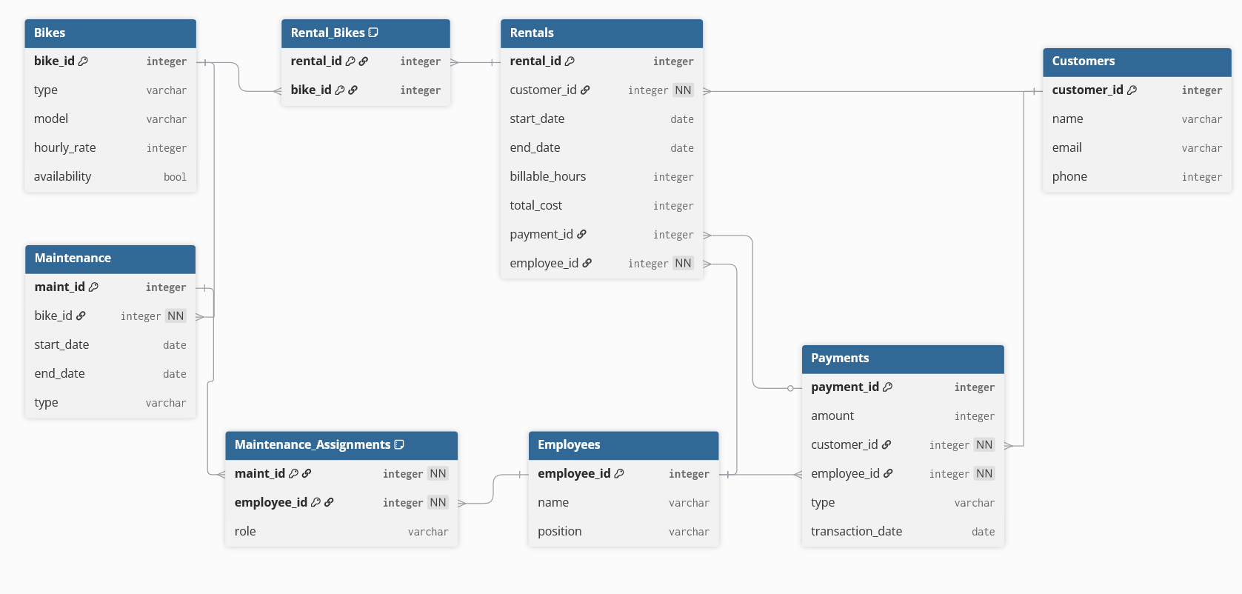
The relation specification contains the full structure of each table in the database, along with junction tables to facilitate the many-to-many relationships between some tables.

